Slide 1
Movie Recommendation Systems

Slide 2
Recommendation Systems are a type of information filtering systems.
As they improve the quality of search results and provides items that are more relevant to the search item or are related to the search history of the user.
They are used to predict the rating or preference that a user would give to an item. Almost every major tech company has applied them in some form or the other: Amazon, YouTube, and Facebook Netflix and Spotify.

Slide 3
Simple Recommender
The System recommends the same movies to users with similar demographic features. The basic idea behind this system is that movies that are more popular and critically acclaimed will have a higher probability of being liked by the average audience.
This model does not give personalized recommendations based on the user.
The implementation of this model is extremely trivial. All we must do is sort our movies based on ratings and popularity and display the top movies of our list. As an added step, we can pass in a genre argument to get the top movies of a genre.

Slide 4
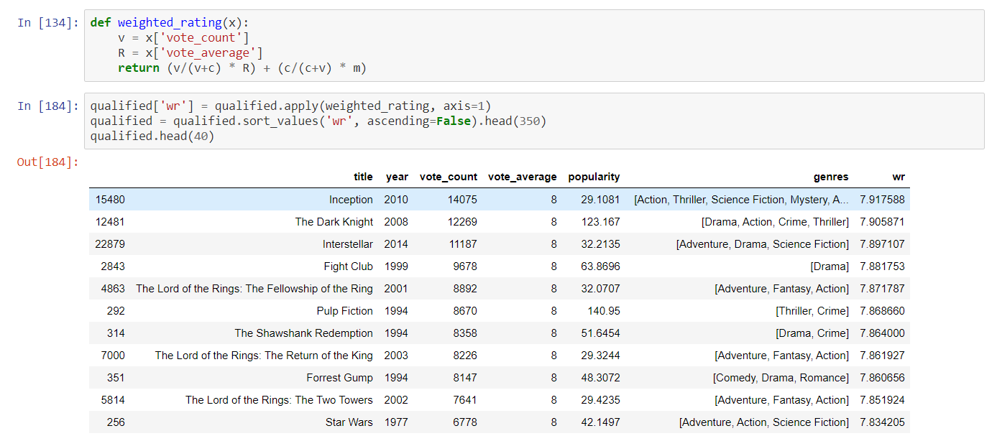

Slide 5
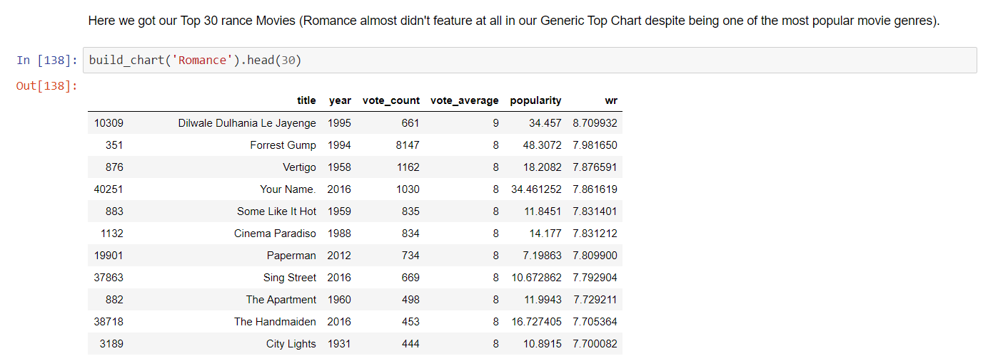

Slide 6
Content Based Recommender
This system uses item metadata, such as genre, director, description, actors, etc. for movies, to make these recommendations. The general idea behind these recommender systems is that if a person liked item, he or she will also like an item that is similar to it.
We built two Content Based Recommenders based on:
Movie Overviews and Taglines
Movie Cast, Crew, Keywords and Genre
We used the Cosine Similarity to calculate a numeric quantity that denotes the similarity between two movies. Mathematically, it is defined as follows:cosine(x,y)=(x.y⊺)/(||x||.||y||)

Slide 7
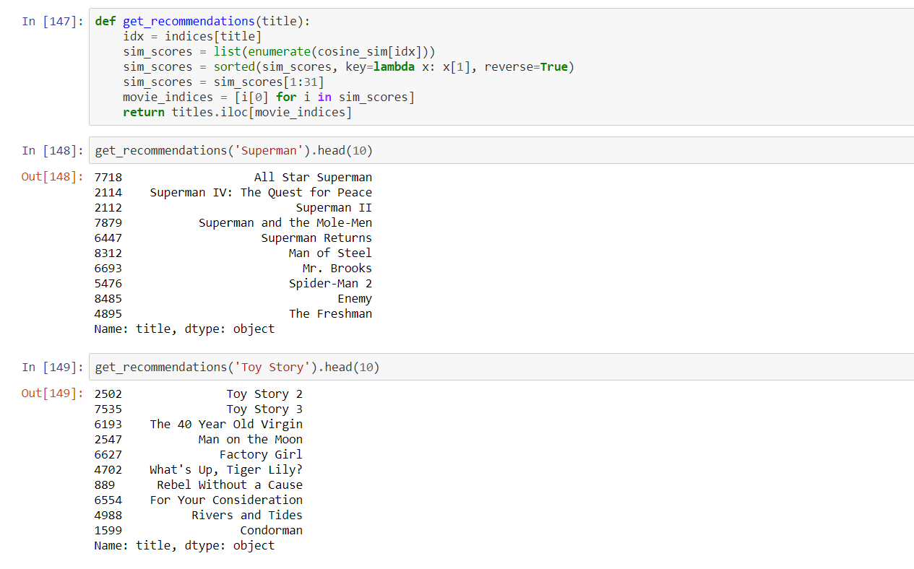
Movie Description Based

Slide 8
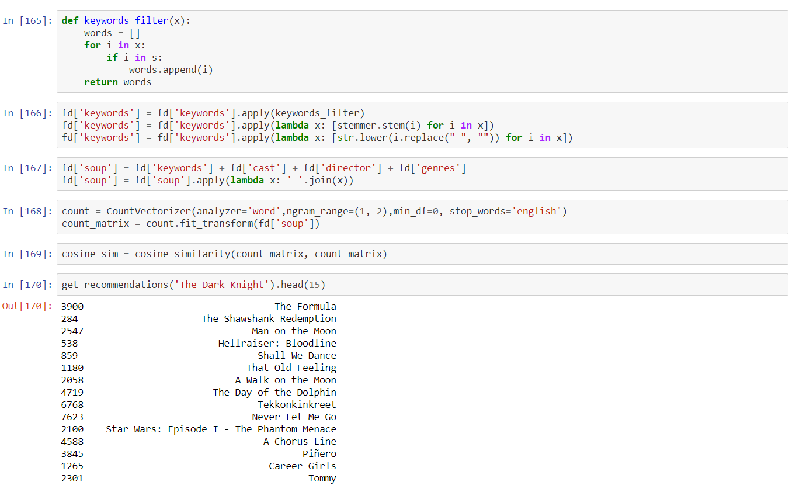
Metadata Based Recommender

Slide 9
Popularity and Ratings
We will add a mechanism to remove bad movies and return movies which are popular and have had a good critical response.
We will take the top 25 movies based on similarity scores and calculate the vote of the 60th percentile movie. Then, we will calculate the weighted rating of each movie using IMDB's formula.

Slide 10
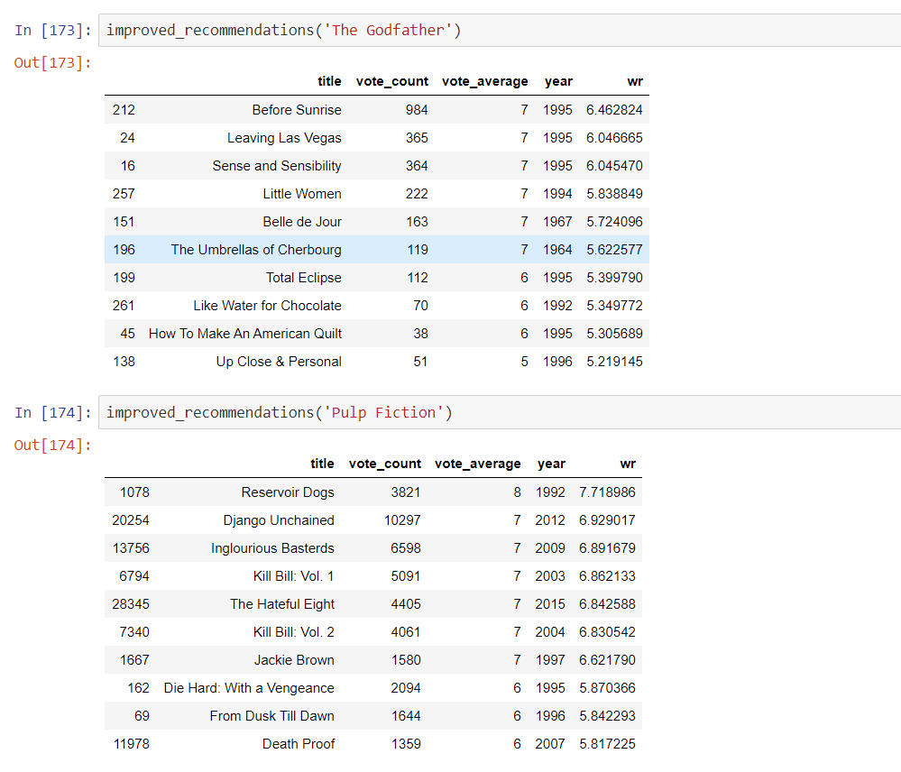

Slide 11
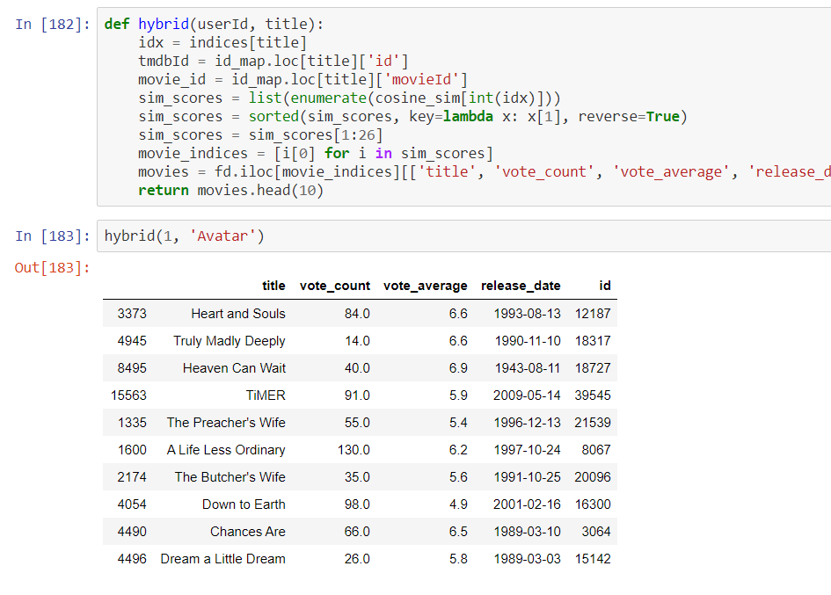
Hybrid Recommender
Hybrid Systems can take advantage of content-based and collaborative filtering as the two approaches are proved to be almost complimentary.

Slide 12
Conclusion:
We created recommenders using demographic , content- based and collaborative filtering.
While demographic filtering is very elementary and cannot be used practically,
Hybrid Systems can take advantage of content-based and collaborative filtering as the two approaches are proved to be almost complimentary.
This model was very baseline and only provides a fundamental framework to start with.

